Slide 1
Tension in Hanging Signs
St. Augustine Preparatory School
October 22, 2015

Slide 2
Theory
The theory for questions where we are analyzing hanging signs is very similar to when we analyzed pulleys and tension
The force of gravity will act straight downwards and the tension in the cable will have to be equal and opposite to the force of gravity (or else the sign would fall to the ground).
The sign is considered to be at equilibrium (all forces cancel)

Slide 3
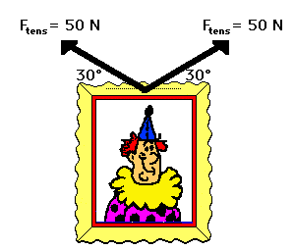
Problem 1
A sign is hung by two separate cables that connect at the middle of the sign, each with an angle of 30.0 degrees to the horizontal. If the force of tension in each of the cables is 50.0 N, what is the weight of the sign?

Slide 4
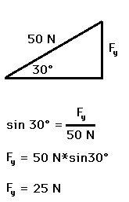
Solution
The weight of the sign, F_{g}, is equal to the two upward y-components of the tension.
If there are two cables and each
supports 25N of force in the
y-direction, then the weight of the sign will be:
Weight = 25N + 25N = 50N

Slide 5
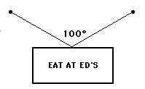
Problem 2
Using the following diagram, calculate the force of tension in each of the two cables that hold up the 5.00kg sign.

Slide 6
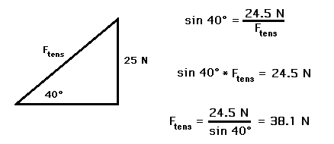
Solution
We need to first calculate the force of gravity on the sign:
Fg = mg = (5.0kg)(-9.81m/s²) = -49.05 N
Since there are two cables and they are at the same angle as each other, each one will take half of the force:
-49.05N / 2 cables = -24.525N/cable
We now know the y-component of the tension force. We can find the resultant (total) tension in the cable:

Slide 7
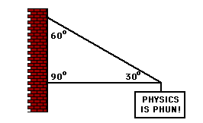
Problem 3
The sign below hangs outside the physics classroom, advertising the most important truth to be found inside. The sign is supported by a diagonal cable and a rigid horizontal bar. If the sign has a mass of 50 kg, then determine the tension in the diagonal cable that supports its weight.

Slide 8
Solution
You must first calculate the force of gravity on the sign:
Fg = mg = (50.0kg)(9.81m/s²) = -490.5N
Diagram
We can calculate the force of tension in the cable now since we have an angle and we have the force component in the y-direction
F_{T,x} – not needed
60°
F_{T,y} = 490.5 N

Slide 9
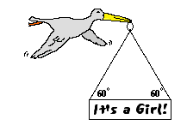
Problem 4
After its most recent delivery, the infamous stork announces the good news. If the sign has a mass of 10 kg, then what is the tensional force in each cable?

Slide 10
Solution
Find the force of gravity on the sign:
Fg = mg = (10.0kg)(-9.81m/s²) = -98.1N
Since there is two cables at an equal angle, each will take half of the force:
98.1N / 2 cables = 49.05N per cable
F_{T} can be found by:
49.05N
F_{T} = ?

Slide 11
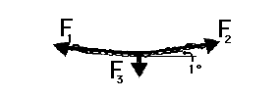
Problem 6
Suppose that a student pulls with two large forces (F₁ and F₂) in order to lift a 1-kg book by two cables. If the cables make a 1-degree angle with the horizontal, then what is the tension in the cable?

Slide 12
Solution
Find the force of gravity
Fg = mg = (1.00kg)(-9.81m/s²) = -9.81 N
2 cables, so each one takes half of the Fg:
9.81N / 2 cables = 4.905N
Calculate the force of tension:

